Slide 1
Electricity & Magnetisms 1
Dr Harrison Lee
Office: G6519
Consultation hour: Thu 10 am – 11 am

Slide 2
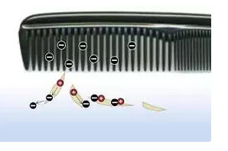
Static electricity
Daily life examples:
When rubbing a comb against your dry hair, the comb can attract small pieces of paper.
When taking off a cloth in dry weather, there is spark.
https://www.youtube.com/watch?v=vyp8YAyawmI

Slide 3
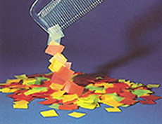
What is the attractive force between the paper and the comb?
Static cling:
An electrical phenomenon in dry weather
Small pieces of paper stick to one another and to the plastic comb
Your clothing to stick to your body.

Slide 4
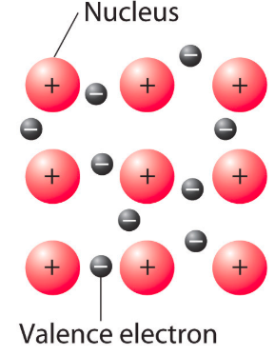
Charging by friction
Matter consists of positive and negative charge
Positive nucleus, cannot move
Negative electrons, can move
Electrons are transferred by friction when one material rubs against another
Rub the comb, negative charge go to the comb
Negative and positive charge attracts each other
Same charge repels

Slide 5
Charged comb attracts paper
Negative charge in the comb repels negative charge in the paper and attracts the positive charge in the paper (induced charge in paper)
The negative charge is moved to a farther distance from the comb

Slide 6

Spark due to static electricity
When taking off your clothes in dry weather, the clothe rubs against your body
Positive charge and negative charge separates between your body and clothe
Electric charges go through the dry air and combine, create the spark.

Slide 7
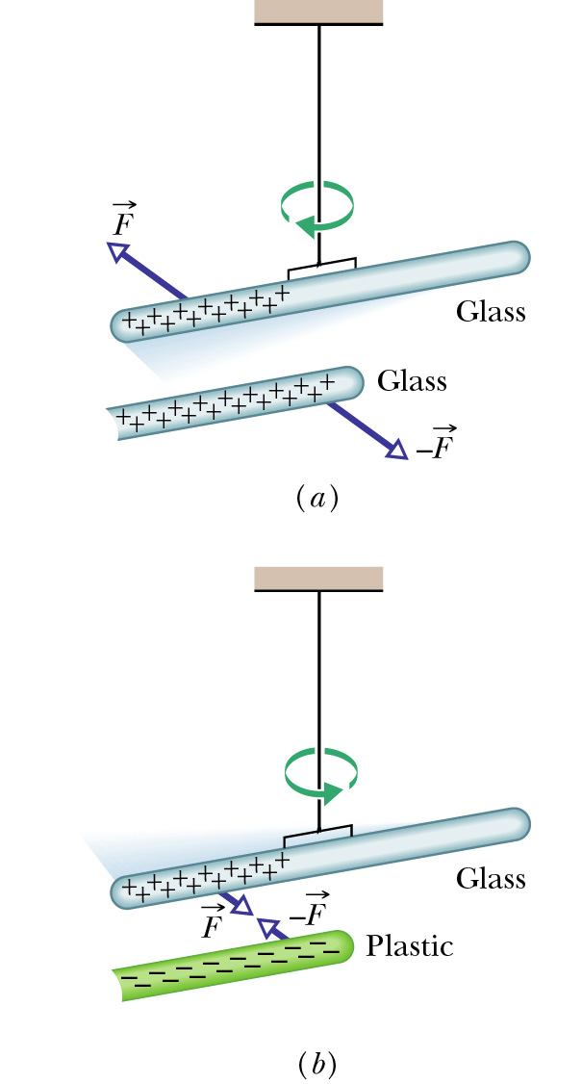
Positive and negative electric charge
There are positive and negative charges
Same charge repel each other.
Opposite charge attract each other.
The comb attracts paper because of this force between charges

Slide 8
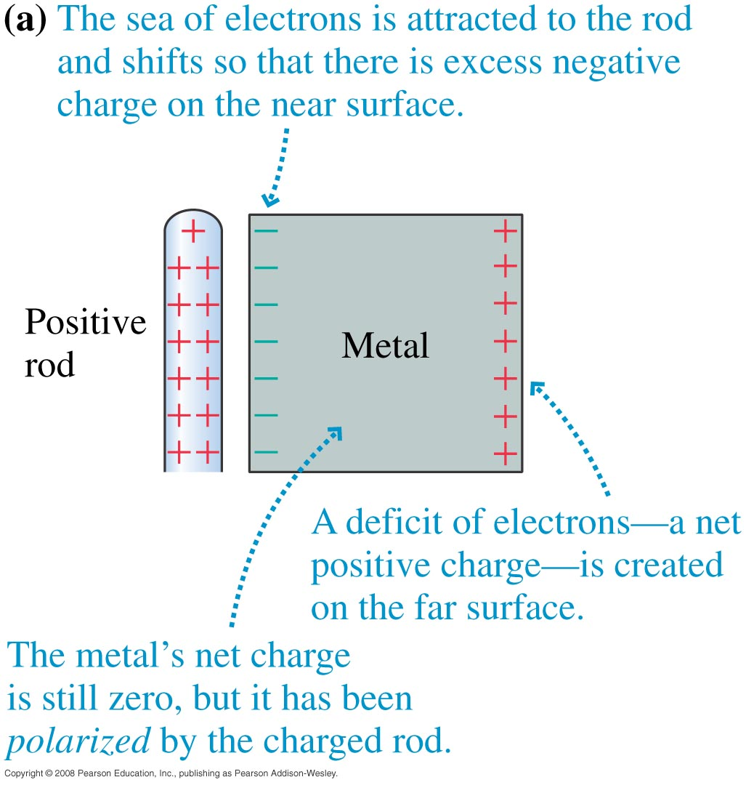
Induced charge in metal
In metal the charges have higher mobility and thus move to a farther place
Metal is called conductor, where charges can move freely
Paper and plastics are insulator where charges can move within a limited distance

Slide 9
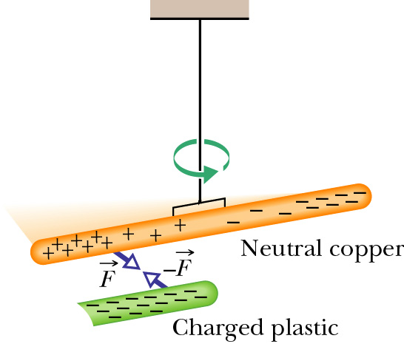
Induced charge in a metal rod
A neutral copper rod is electrically isolated from its surroundings by being suspended on a non-conducting thread.
Either end of the copper rod will be attracted by a charged rod.
Here, electrons in the copper rod are repelled to the far end of that rod by the negative charge on the plastic rod.
Then that negative charge attracts the remaining positive charge on the near end of the copper rod, rotating the copper rod to bring that near end closer to the plastic rod.

Slide 10
How to detect charges: Gold leave electroscope
When the brass disc is touched by a charged body, the leaves that normally hang straight down spread apart.

Slide 11
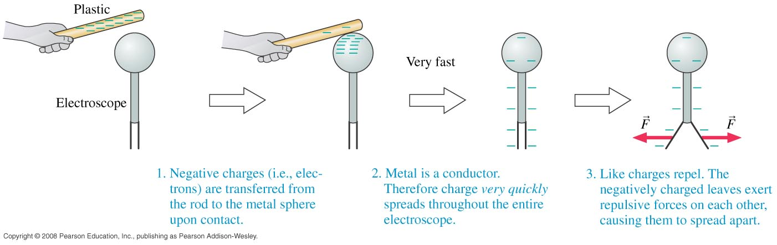
Detect by charge transfer

Slide 12
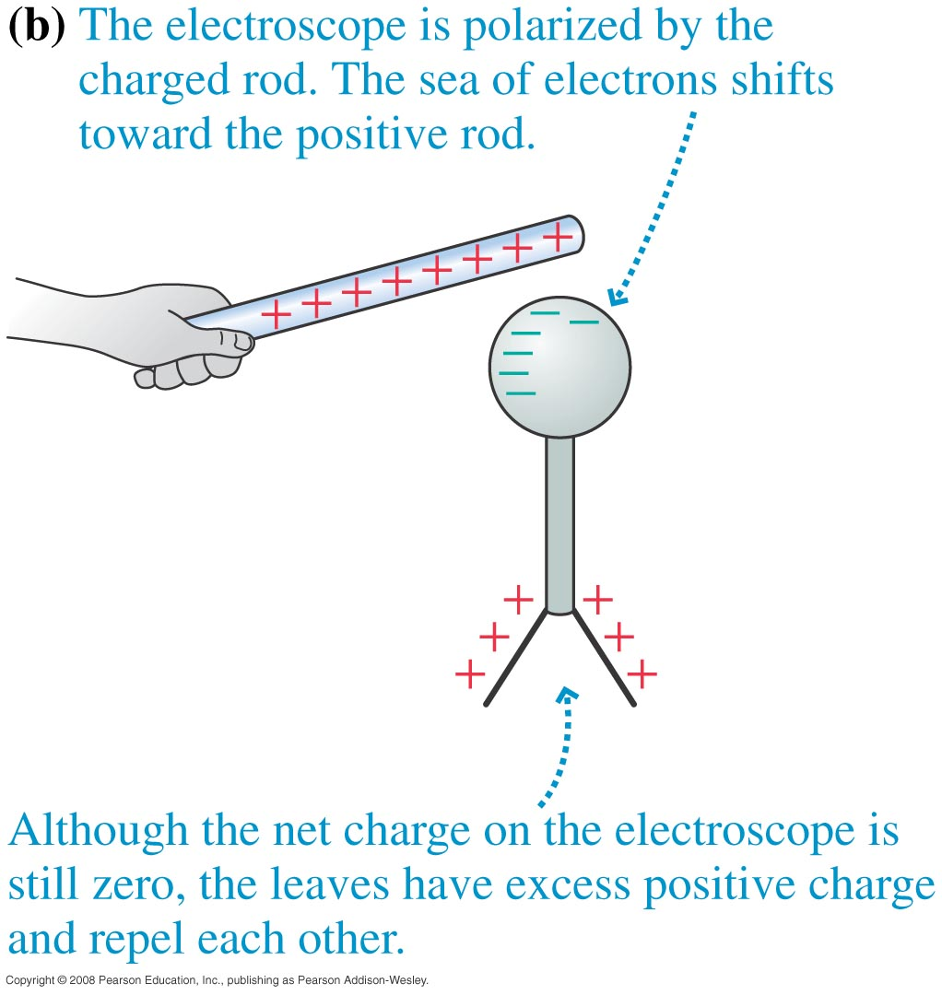
Detect by polarization
https://www.youtube.com/watch?v=Jejcyih_uGs

Slide 13
Summary
Matters consist of particles and they are charged.
Electrons (negative)
Nucleus (positive)
Same charges repel
Opposite charges attract

Slide 14
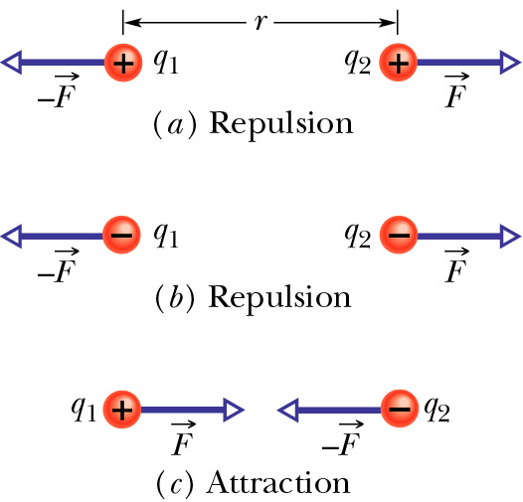
The force between charges – Coulomb’s law
Two charged particles, separated by distance r, repel each other if their charges are (a) both positive and (b) both negative. (c) They attract each other if their charges are of opposite signs
The force acting on one particle is equal in magnitude to the force acting on the other particle but has the opposite direction.

Slide 15
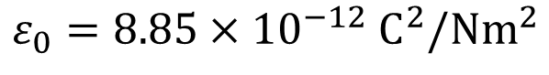
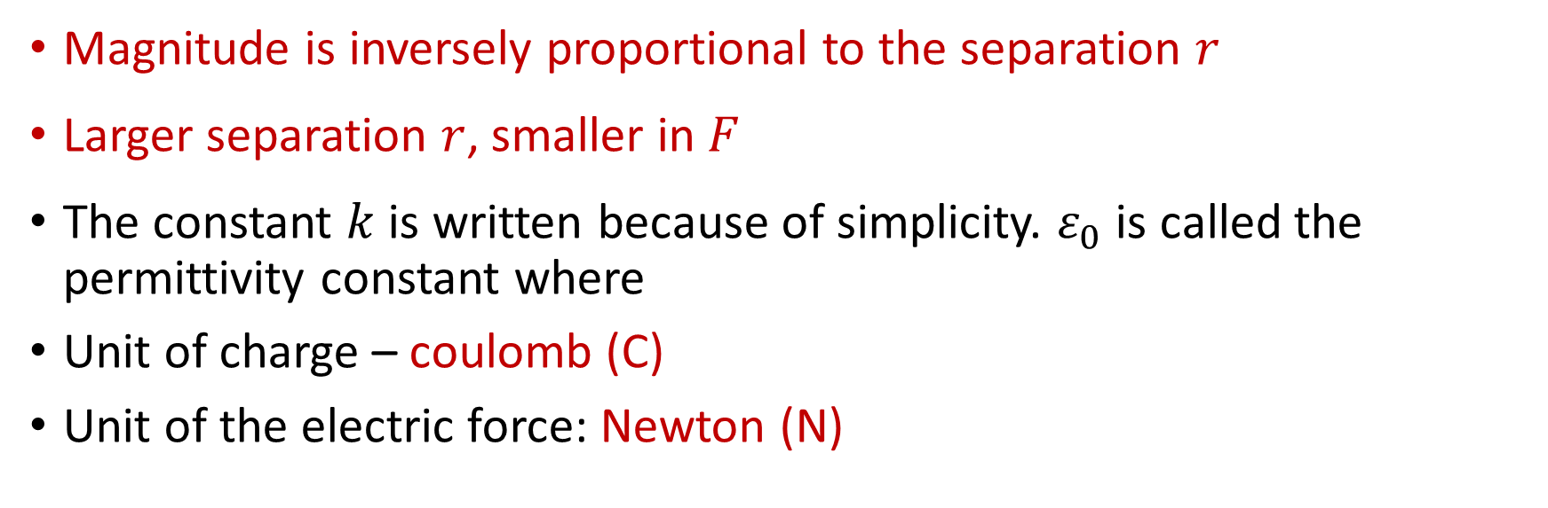
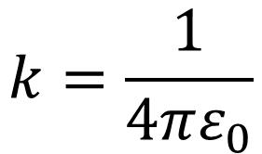
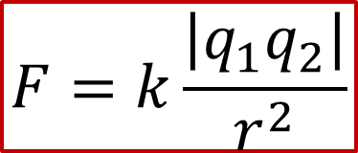
The force between charges – Coulomb’s law
$$F=k\frac{\left|q_{1}q_{2}\right|}{r^{2}}$$
$$k=\frac{1}{4πε_{0}}$$
, where
Magnitude is inversely proportional to the separation $r$
Larger separation $r$, smaller in $F$
The constant $k$ is written because of simplicity. $ε_{0}$ is called the permittivity constant where
Unit of charge – coulomb (C)
Unit of the electric force: Newton (N)
$$ε_{0}=8.85×{10}^{−12} C^{2}/Nm^{2}$$

Slide 16
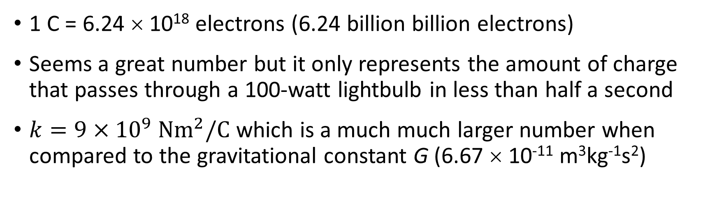
The force between charges – Coulomb’s law
$$F=k\frac{\left|q_{1}q_{2}\right|}{r^{2}}$$
$$k=\frac{1}{4πε_{0}}$$
, where
1 C = 6.24 × 10¹⁸ electrons (6.24 billion billion electrons)
Seems a great number but it only represents the amount of charge that passes through a 100-watt lightbulb in less than half a second
$k=9×{10}^{9} Nm^{2}/C$ which is a much much larger number when compared to the gravitational constant G (6.67 × 10⁻¹¹ m³kg⁻¹s²)

Slide 17

Action at a distance
We know that q₁exerts
a repulsive force on q₂.
q₁ and q₂ are not in contact.
It is called action at a distance
F
+q₁
+q₂
F
The man push the car with a force,
it requires contact, not action at a distance

Slide 18
Electric field and action at a distance
How to exert a force without contact?
q₁ sets up an electric field
in the space surrounding it.
q₂ is in the field and experiences a force
F
+q₁
+q₂
F

Slide 19
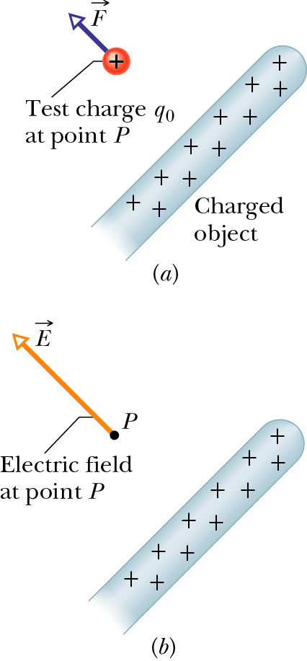
Electric field
A positive test charge q₀ placed at point P near a charged object. The test charge experiences a force F
The force comes from the electric field E at point P produced by the charged object.

Slide 20
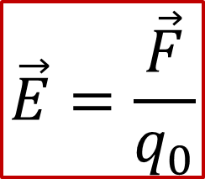
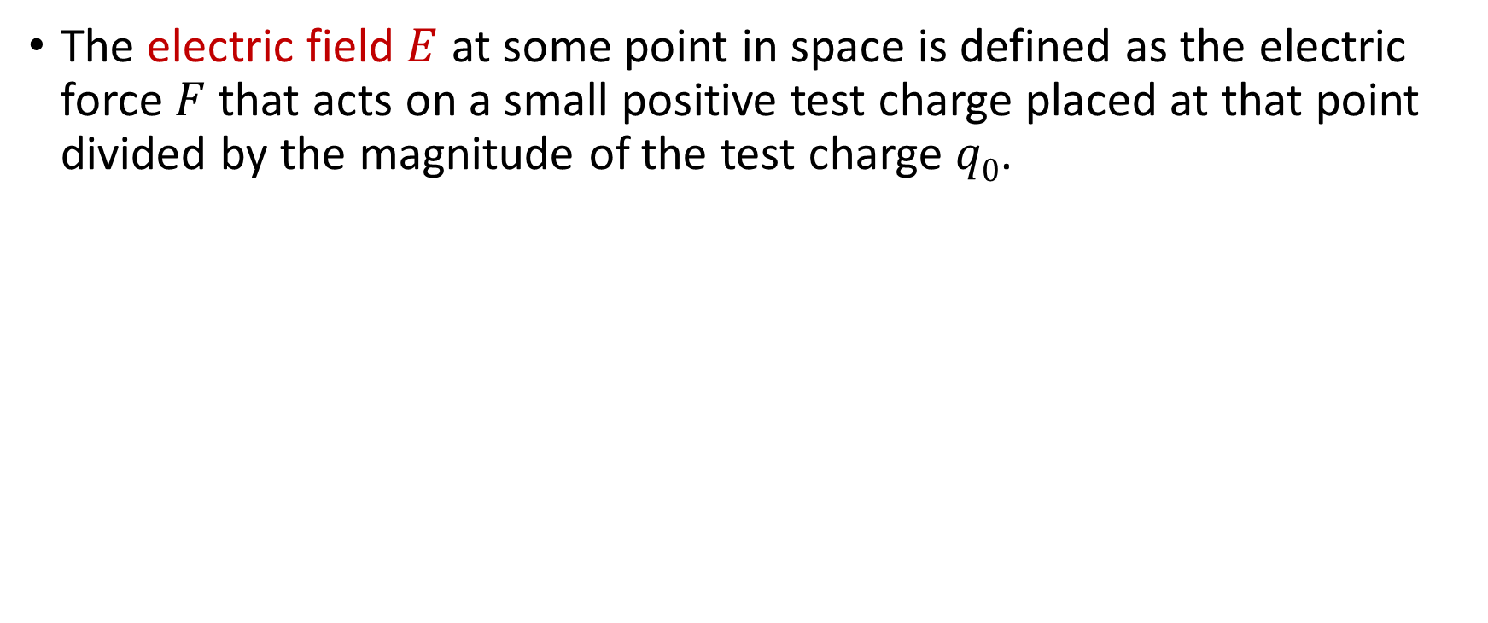
Definition of electric field
The electric field $E$ at some point in space is defined as the electric force $F$ that acts on a small positive test charge placed at that point divided by the magnitude of the test charge $q0$.
$$\vec{E}=\frac{\vec{F}}{q_{0}}$$

Slide 21
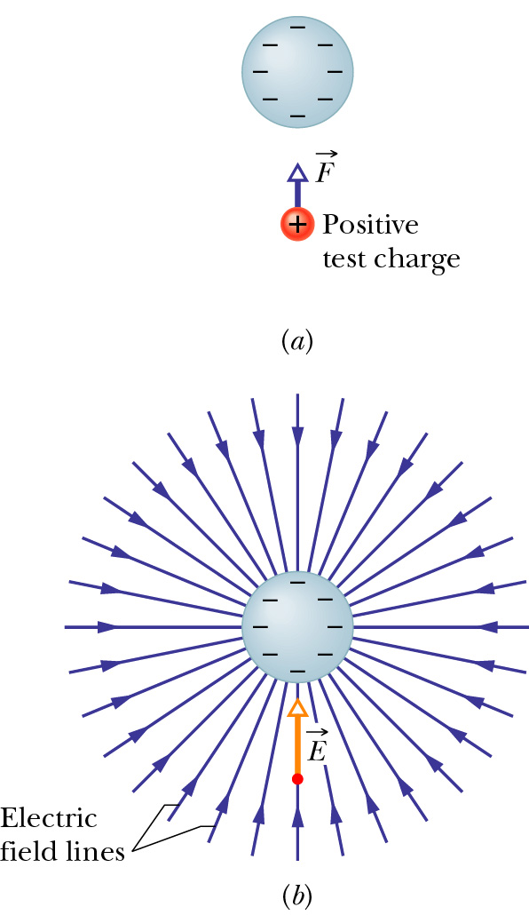
Electric field lines
The electrostatic force F acting on a positive test charge near a sphere of uniform negative charge.
The electric field vector E at the location of the test charge, and the electric field lines in the space near the sphere. The field lines extend toward the negatively charged sphere. (They originate on distant positive charges.)
Electric field lines provide a way to visualize patterns in electric fields.

Slide 22
Electric field lines
Electric field lines show the direction of the field at each point.
Force and field are vectors, so direction is important.
The line does not show the magnitude of the field but the density of the lines can be related to the magnitude, higher density means stronger field.

Slide 23
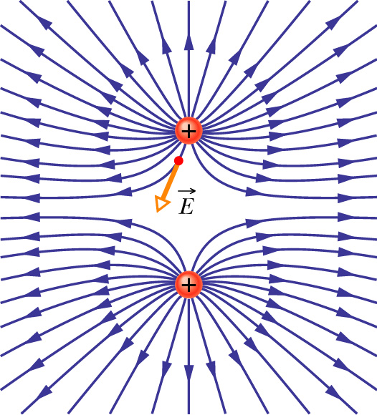
Electric field lines
Field lines for two equal positive point charges. The charges repel each other. (The lines terminate on distant negative charges.)
To “see” the actual three-dimensional pattern of field lines, mentally rotate the pattern shown here about an axis passing through both charges in the plane of the page.
The electric field vector at one point is shown; note that it is tangent to the field line through that point.

Slide 24
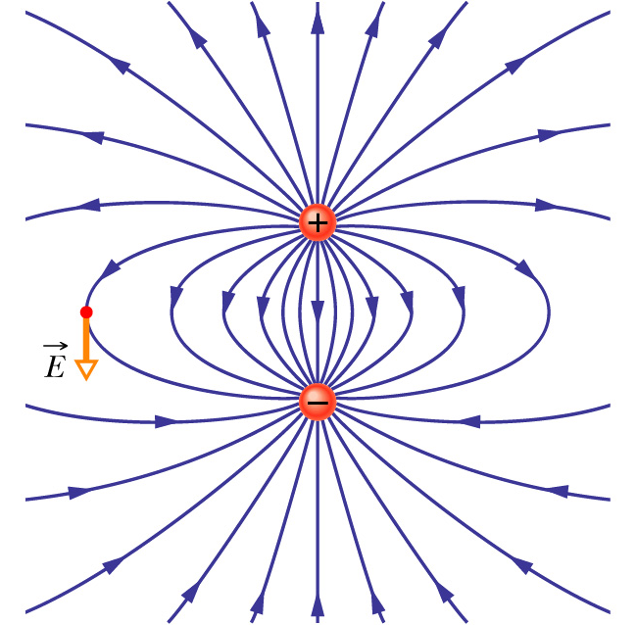
Electric field lines
Field lines for a positive and a nearby negative point charge that are equal in magnitude. The charges attract each other.
The pattern of field lines and the electric field it represents have rotational symmetry about an axis passing through both charges in the plane of the page.
The electric field vector at one point is shown; the vector is tangent to the field line through the point.

Slide 25
Electric potential energy
Two charges can attract or repel
They can move each other
Force x distance = work done = energy
So electric field possesses energy
The energy is potential energy and depends on position.
For positive charge, higher potential near the positive plate
Negative charge is attracted towards the positive plate, position near to the positive plate has lower potential energy for the negative charge
Position farther from the positive plate has higher potential energy for the negative charge

Slide 26
Compare with gravitational potential energy
Similar to gravitational potential energy

Slide 27
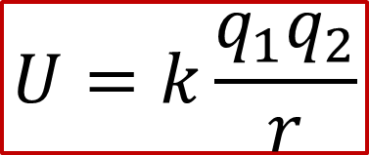
Electric potential energy
Suppose we have two charges that are very far apart (separation = infinity). How much energy is needed to squeeze the two charges together?
The energy is equal to the potential energy of the two-charge system
The potential energy is negative when the charges are of opposite sign (attractive force). This means that energy input is required to separate the charges to infinity.
$$U=k\frac{q_{1}q_{2}}{r}$$
The usual convention is U = 0 when r = ∞.

Slide 28
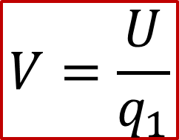
Electric potential
The potential energy of a charged particle in an electric field depends on the magnitude of the charge. However, the potential energy per unit charge (Joule per Coulume) has a unique value at any point in an electric field.
The potential energy per unit charge, which can be symbolized as U/q, is independent of the charge q of the particle we happen to use and is characteristic only of the electric field we are investigating.
Electric potential equals to zero at a point does not necessarily mean that the electric field is also equal to zero at that point.
$$V=\frac{U}{q_{1}}$$

Slide 29
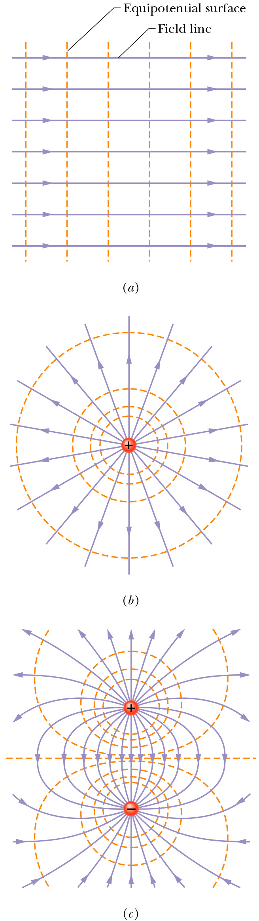
Equipotential Surfaces
For a uniform electric field, the field lines are evenly spaced and parallel. The equipotential surfaces are perpendicular to the field lines.
In fact, equipotential surfaces are always perpendicular to electric field lines and thus to E, which is always tangent to these lines. If E were not perpendicular to an equipotential surface, it would have a component lying along that surface. This component would then do work on a charged particle as it moved along the surface.

Slide 30
Electric field in a conductor
An uncharged conductor is suspended in an external electric field. The free electrons in the conductor distribute themselves on the surface as shown, so as to reduce the net electric field inside the conductor to zero and make the net field at the surface perpendicular to the surface.
https://www.youtube.com/watch?v=pjw5gbkRTaY
https://www.youtube.com/watch?v=m37z5R2rJ5E

Slide 31
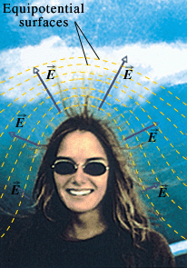
Charging by cloud
The woman was standing on a platform that was connected to the mountainside, she was at about the same potential as the mountainside. Overhead, a highly charged cloud system had moved in and created a strong electric field around her and the mountainside, with E pointing outward from her and the mountain. Electrostatic forces due to this field drove some of the conduction electrons in the woman downward through her body, leaving strands of her hair positively charged.
https://www.youtube.com/watch?v=vn5mDA1GNh8
https://www.youtube.com/watch?v=jZEFuCxD7BE

Slide 32
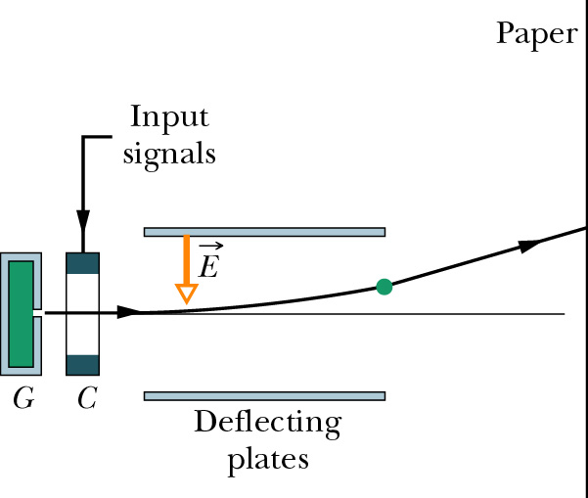
Ink-jet printing
Ink-jet Printing
The essential features of an ink-jet printer. Drops are shot out from generator G and receive a charge in charging unit C. An input signal from a computer controls the charge given to each drop and thus the effect of field E on the drop and the position on the paper at which the drop lands. About 100 tiny drops are needed to form a single character.

Slide 33
Laser printing

Slide 34
Capacitors
A capacitor is a device you can use to store electric energy.
Examples of application: photoflash unit, radio and TV transmitters and receivers, etc.

Slide 35
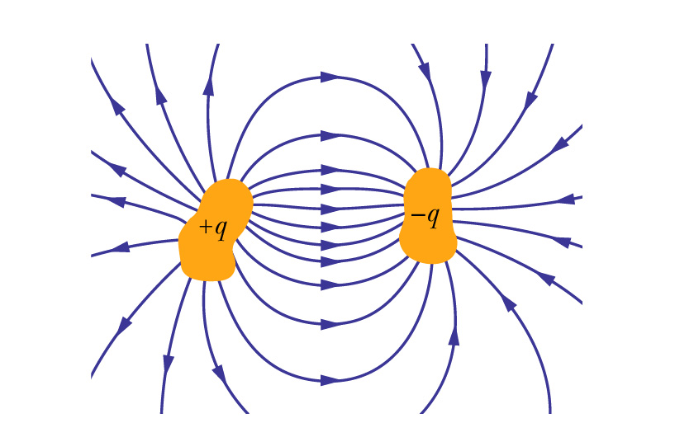
Basic elements of any capacitor
A capacitor consists of two isolated conductors of any shape. No matter what their geometry, we call these conductors plates.
Two conductors, isolated electrically from each other and from their surroundings, form a capacitor. When the capacitor is charged, the conductors, or plates as they are called, have equal but opposite charges of magnitude q.

Slide 36
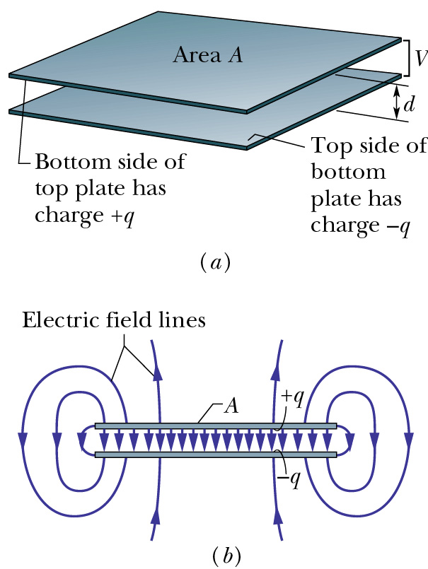
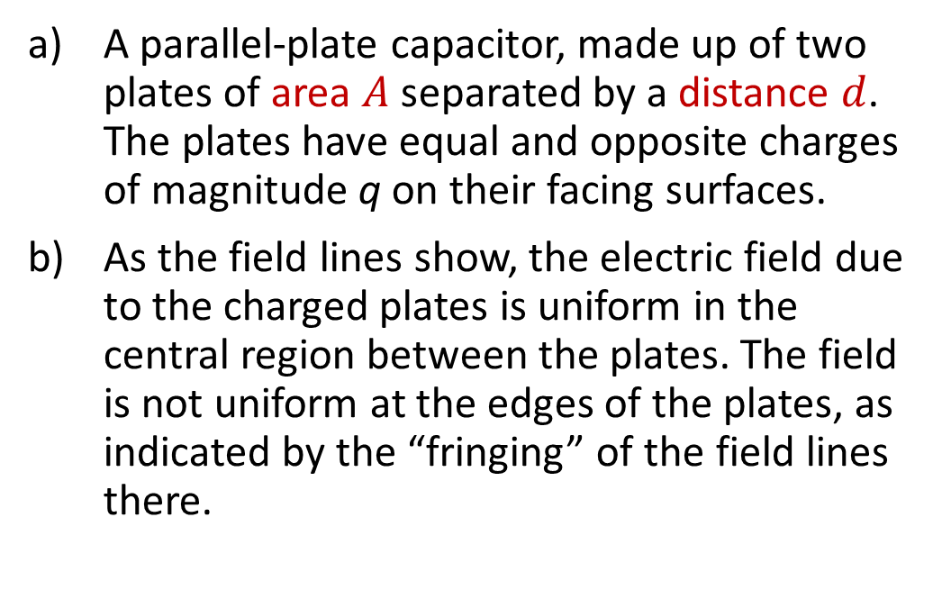
Parallel plate capacitor
A parallel-plate capacitor, made up of two plates of area $A$ separated by a distance $d$. The plates have equal and opposite charges of magnitude q on their facing surfaces.
As the field lines show, the electric field due to the charged plates is uniform in the central region between the plates. The field is not uniform at the edges of the plates, as indicated by the “fringing” of the field lines there.

Slide 37
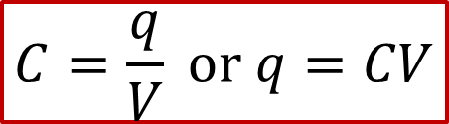
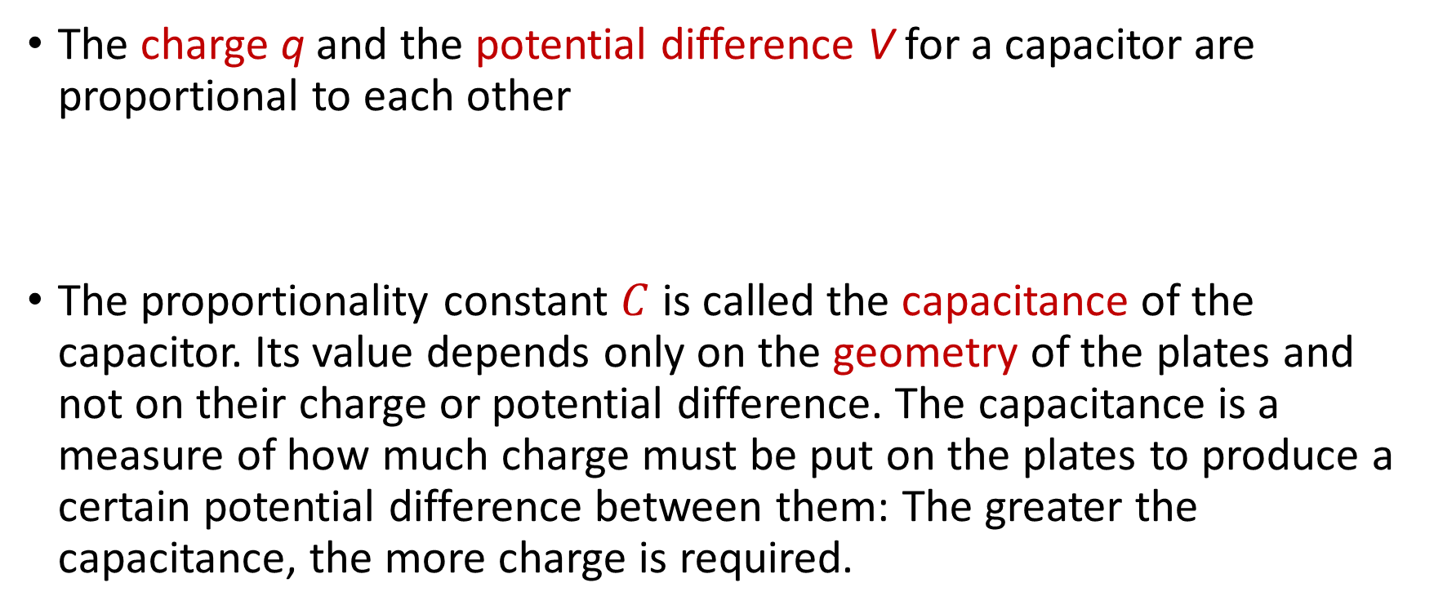
Capacitance
The charge q and the potential difference V for a capacitor are proportional to each other
The proportionality constant $C$ is called the capacitance of the capacitor. Its value depends only on the geometry of the plates and not on their charge or potential difference. The capacitance is a measure of how much charge must be put on the plates to produce a certain potential difference between them: The greater the capacitance, the more charge is required.
$$C=\frac{q}{V} or q=CV$$

Slide 38
Capacitor
The two plates of the capacitor has different potential and thus charges in the two plates have different potential energy
When charges move from one plate to another, the potential energy is released.

Slide 39

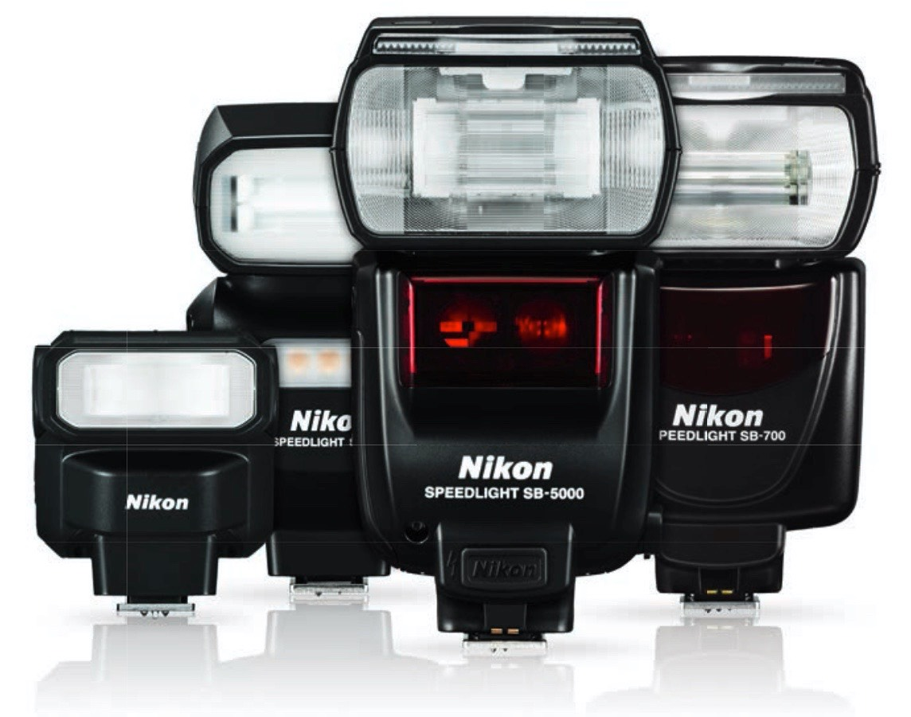
Flash for camera
In flash photography, the energy used to make the flash is stored in a capacitor.
The energy release from the capacitor is very fast, therefore the flash is bright but can only last for a short time.

Slide 40
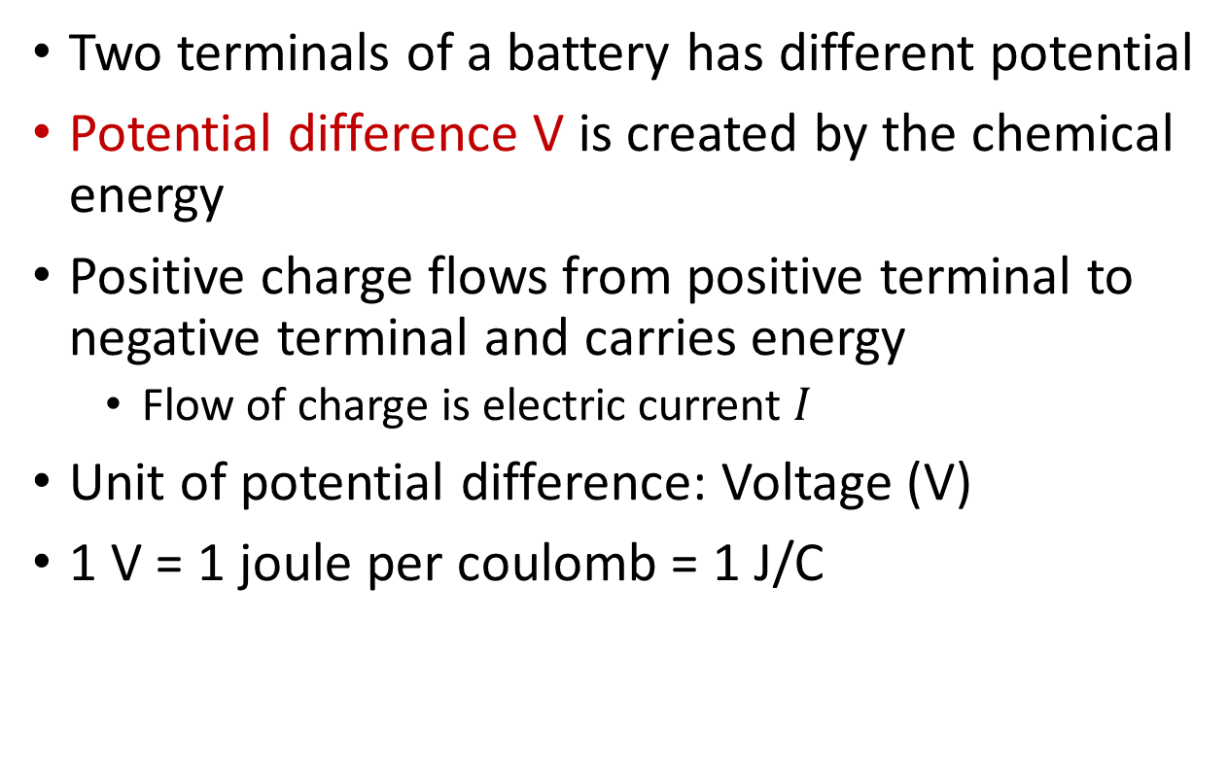
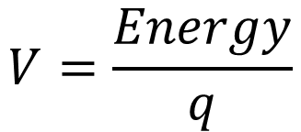
Battery
Two terminals of a battery has different potential
Potential difference V is created by the chemical energy
Positive charge flows from positive terminal to negative terminal and carries energy
Flow of charge is electric current $I$
Unit of potential difference: Voltage (V)
1 V = 1 joule per coulomb = 1 J/C
$$V=\frac{Energy}{q}$$
Higher potential
Lower potential

Slide 41
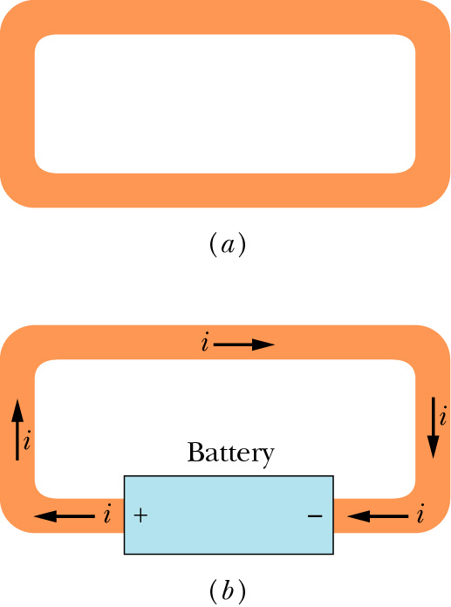
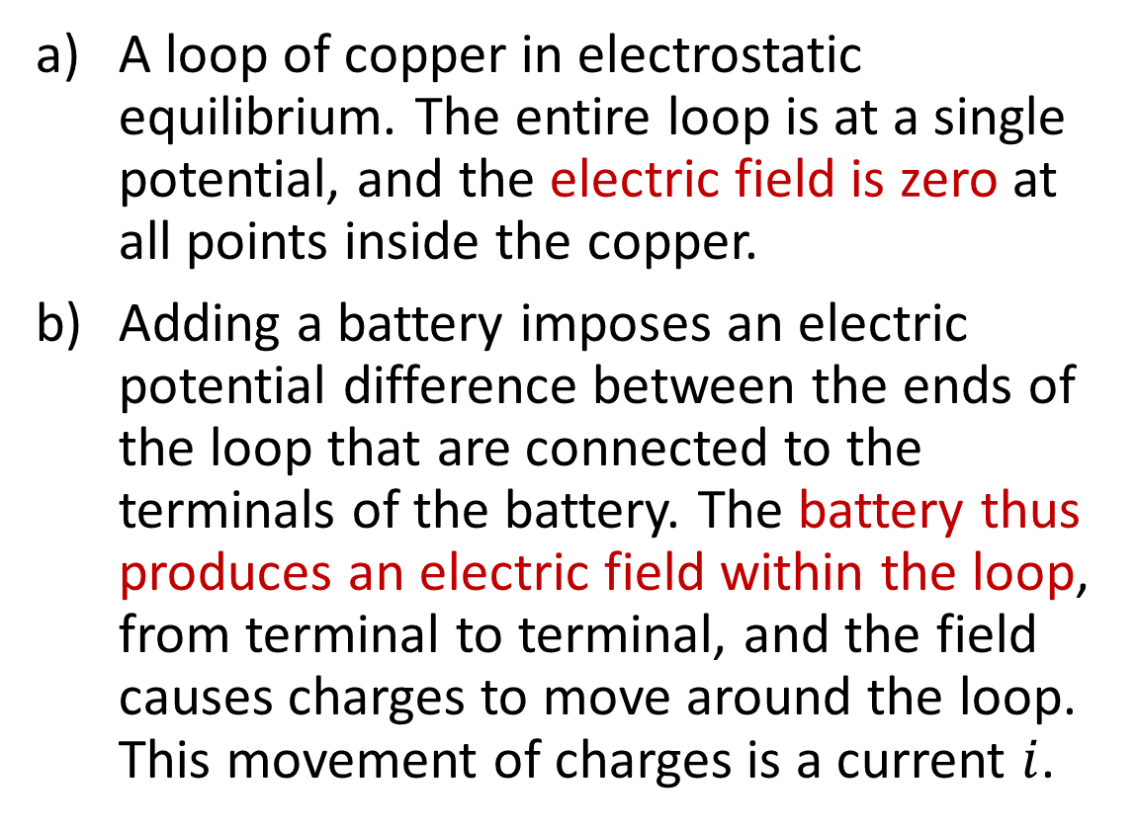
Electric current
A loop of copper in electrostatic equilibrium. The entire loop is at a single potential, and the electric field is zero at all points inside the copper.
Adding a battery imposes an electric potential difference between the ends of the loop that are connected to the terminals of the battery. The battery thus produces an electric field within the loop, from terminal to terminal, and the field causes charges to move around the loop. This movement of charges is a current $i$.

Slide 42
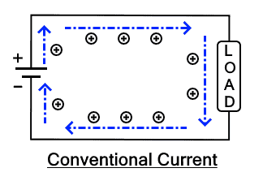
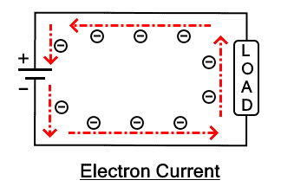
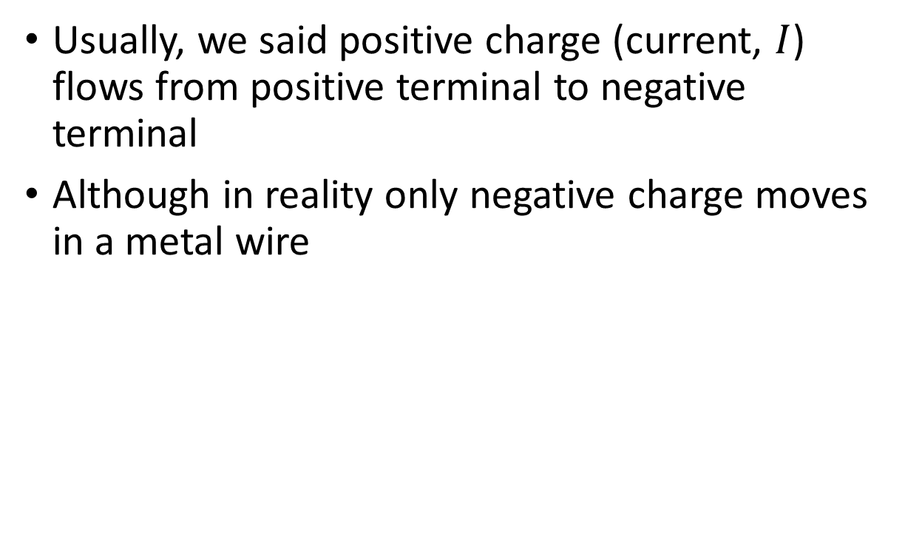
Flow of charge
Usually, we said positive charge (current, $I$) flows from positive terminal to negative terminal
Although in reality only negative charge moves in a metal wire
Current flow
Electron flow

Slide 43
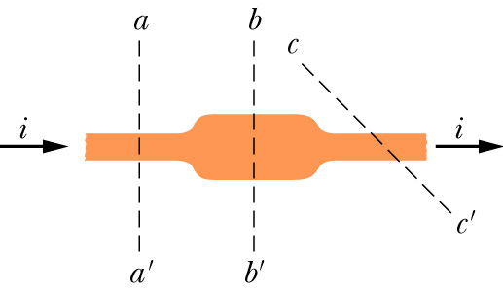
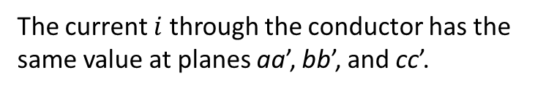
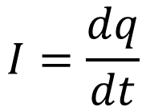
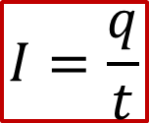
Electric current
Current is defined as the rate of flow of electric charge moving through an electrical conductor.
Unit for electric current: Ampere (A)
1 A = 1 coulomb per second = 1 C/s
The current $i$ through the conductor has the same value at planes aa’, bb’, and cc’.
$$I=\frac{q}{t}$$
$$I=\frac{dq}{dt}$$
more advanced expression

Slide 44

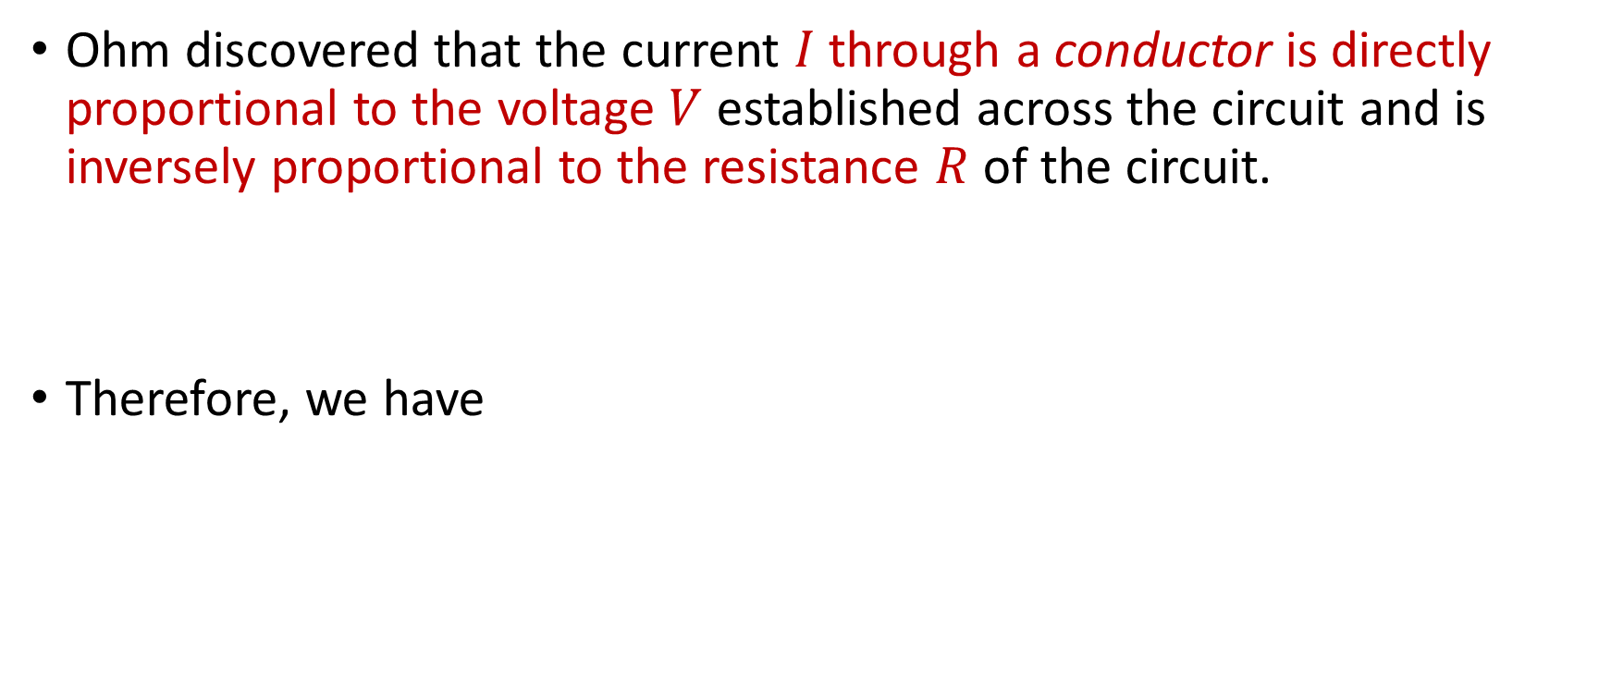
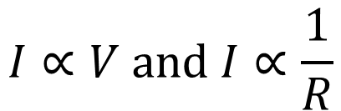
Ohm’s Law
Ohm discovered that the current $I$ through a conductor is directly proportional to the voltage $V$ established across the circuit and is inversely proportional to the resistance $R$ of the circuit.
Therefore, we have
$$I∝V and I∝\frac{1}{R}$$
$$V=IR$$

Slide 45
Summary
Electrostatics
Electric force and electric field
Electric potential energy and electric potential
Electric field line
Basic circuit components
Capacitor, battery, resistor
Ohm’s law

